Slide 1
Review 2 Semester Internship
Project Guide:
C. Fancy Ma’am (Asst. Professor)
Department of Networking and Communications
SRMIST KTR
Student Name: Parivesh Sood
Reg. No.: RA1811029010018
Batch No.: NWC018

Slide 2
Project Title:
The IMAGE CLASSIFICATION USING DEEP LEARNING (DL) and comparing with SUPPORT VECTOR MACHINE (SVM).

Slide 3
Use Case:
Car Number detection from Number Plate
It includes the information about the Traditional Pattern Recognition Techniques of SVM and classification using Deep Learning with Convolutional Neural Networks.

Slide 4
Abstract
In this project, I am asked to experiment with a real world dataset, and to explore how machine learning algorithms can be used to find the patterns in data. I am expected to gain experience using a common data-mining and machine learning library, and am expected to submit a report about the dataset and the algorithms used. I will be doing ‘Image Classification using Deep Learning’ in this project and my use case is ‘Car Number Detection from Number Plate’.

Slide 5
Contents:
Introduction
Understanding the problem
Proposed Method
Existing Framework for previous research
Scope of this project
Training Details
Project Flow
Assumptions
Project Architecture
Details of the project upto now
Few lines of code
Appendix

Slide 6
Introduction
Car Number Detection from Number Plate aims at detection of the License Plate present on a vehicle and then extracting the contents of that License Plate. A vehicle’s license plate is commonly known as ‘a number plate’. It is a metal plate that is attached to a vehicle and has the official registration number of a vehicle embossed on it. Number plates are placed at the front and back of the vehicle and help anyone to identify a vehicle.

Slide 7
Understanding the problem:
The stated problem can be divided into two sub-problems:
Number Plate Detection. This problem can be tackled using the Object Detection approach where we need to train our model using the car/other vehicle images with number plates.
Extracting text from the detected Number Plate. This problem can be solved using OCR(Optical Character Recognition) which can be helpful in extracting alphanumeric characters from cropped Number Plate images.

Slide 8
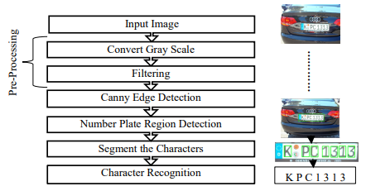
Proposed Method:

Slide 9
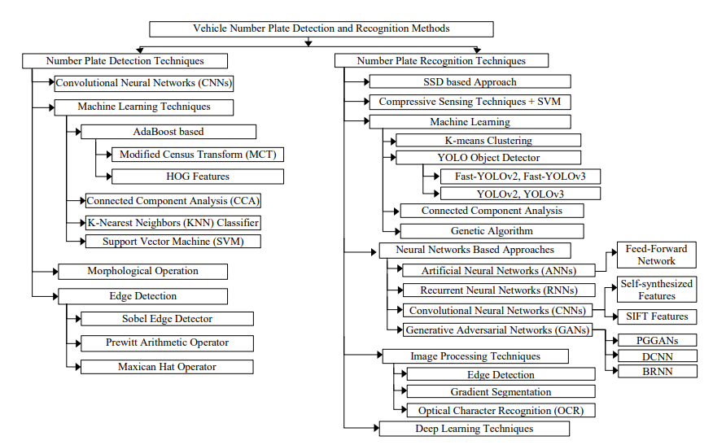
Existing frameworks for previous research:

Slide 10
Scope of this project:
Some places where this solution can be used:
Analysis of city traffic during peak periods
Automation of weigh-in-motion systems
Enhanced vehicle theft prevention
Effective law enforcement
Effective enforcement of traffic rules
Flexible and automatic vehicle entry to and exit from the car park
Management information about car park usage
Improved security for both car park operators and car park users

Slide 11
Training Details:
I am currently being given training in the following topics and have been allotted a problem statement based on these topics:
Python
Linear Algebra
Data Types Understanding
Statistics for AI/ML
Logistics Regression
Feature Engineering

Slide 12
Clustering Analysis
Tree Based Algorithms
Time Series Analysis
Deep Learning
NLP
SQL
Data Visualization (PowerBi)

Slide 13
Project Flow:
I will be creating a ML model for the given problem statement and dataset
I have to follow these steps to build my model:
Step 1. Understand the business problem
Step 2. Understand and identify data
Step 3. Collect and prepare data
Step 4. Determine the model's features and train it
Step 5. Evaluate the model's performance and establish benchmarks
Step 6. Put the model in operation and make sure it works well
Step 7. Iterate and adjust the model

Slide 14
Assumptions:
GPU availability for training
Though trained & tested over only Car images, It should be able to detect Number Plates in any sort of vehicle(Bike, Truck, etc)
Image quality is up to mark
No limitation over Memory and Latency
Internet Availability(For OCR purpose)
Python 3+
Videos not considered

Slide 15
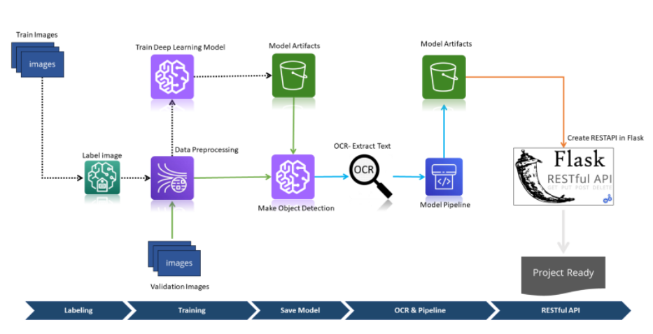
Project Architecture:

Slide 16
Details of the project upto now:
As my project is moving in pace with my internship and in guidance of my mentor from the company, i.e. EY GDS
Till now I have been experimenting with different algorithms to implement the solution for the given problem statement.
I have tried these algorithms as of now:
A)Detection model: YOLOv1, YOLOv2, YOLOv3.For implementing any of the Yolo version, we need a neural network framework i.e either Darknet or Dark flow
B)Text Extraction from Number Plate: A number of pre-existing libraries in python are to be tried out: Pytesseract, Pyocr, textract. Google Vision API and Microsoft Vision API will also be tried up.

Slide 17
Few lines of code: OCR
# Loading the required python modules
import pytesseract
import matplotlib.pyplot as plt
import cv2
import glob
import os
path_for_license_plates = os.getcwd() + "license-plates.jpg"
list_license_plates = []
predicted_license_plates = []

Slide 18
for path_to_license_plate in glob.glob(path_for_license_plates, recursive = True):
license_plate_file = path_to_license_plate.split("/")[-1]
license_plate, _ = os.path.splitext(license_plate_file)
list_license_plates.append(license_plate)
img = cv2.imread(path_to_license_plate)
predicted_result = pytesseract.image_to_string(img, lang ='eng',
config ='--oem 3 --psm 6 -c tessedit_char_whitelist = ABCDEFGHIJKLMNOPQRSTUVWXYZ0123456789')
filter_predicted_result = "".join(predicted_result.split()).replace(":", "").replace("-", "")
predicted_license_plates.append(filter_predicted_result)

Slide 19
print("Actual License Plate", "\t", "Predicted License Plate", "\t", "Accuracy")
print("--------------------", "\t", "-----------------------", "\t", "--------")
def calculate_predicted_accuracy(actual_list, predicted_list):
for actual_plate, predict_plate in zip(actual_list, predicted_list):
accuracy = "0 %"
num_matches = 0
if actual_plate == predict_plate:
accuracy = "100 %"
else:
if len(actual_plate) == len(predict_plate):

Slide 20
for a, p in zip(actual_plate, predict_plate):
if a == p:
num_matches += 1
accuracy = str(round((num_matches / len(actual_plate)), 2) * 100)
accuracy += "%"
print(" ", actual_plate, "\t\t\t", predict_plate, "\t\t ", accuracy)
calculate_predicted_accuracy(list_license_plates, predicted_license_plates)

Slide 21
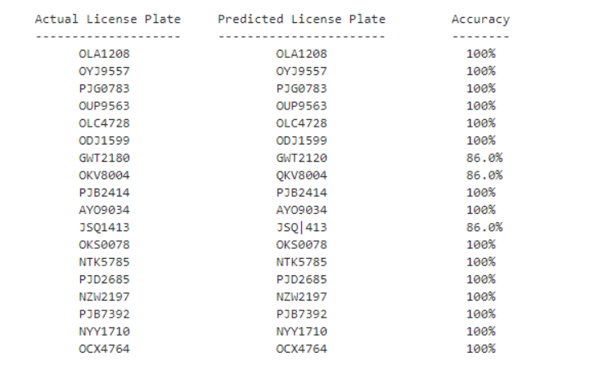
Appendix: Screenshot for OCR

Slide 22
Thank You

